Slide 1
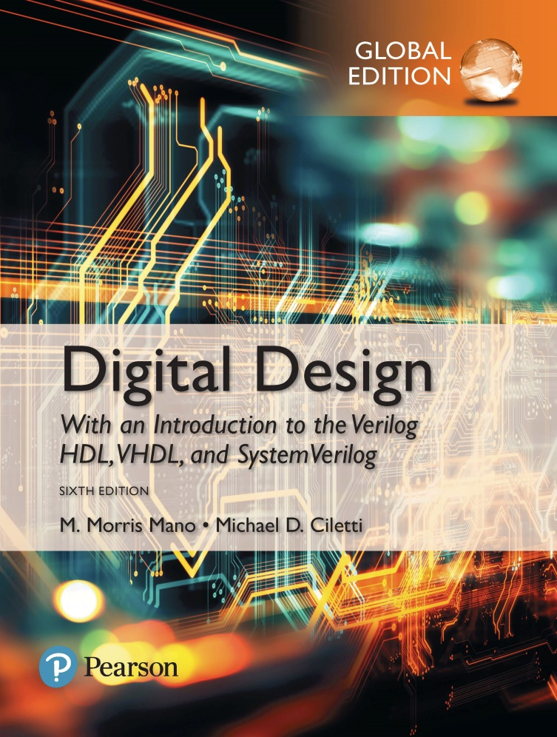
Digital Design
With an Introduction to the Verilog HDL, VHDL, and SystemVerilog
6th Edition, Global Edition
Chapter 07
Memory and Programmable Logic

Slide 2
Introduction
Memory
RAM(random access memory): read and write operation
ROM(read only memory) : only read operation
Volatile?

Slide 3

Conventional and array logic diagrams for OR gate.

Slide 4
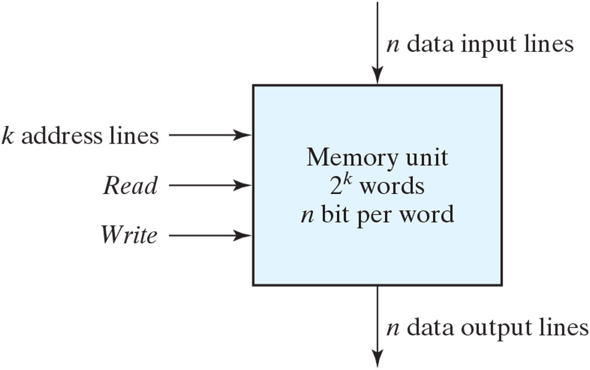
Block diagram of a memory unit.

Slide 5
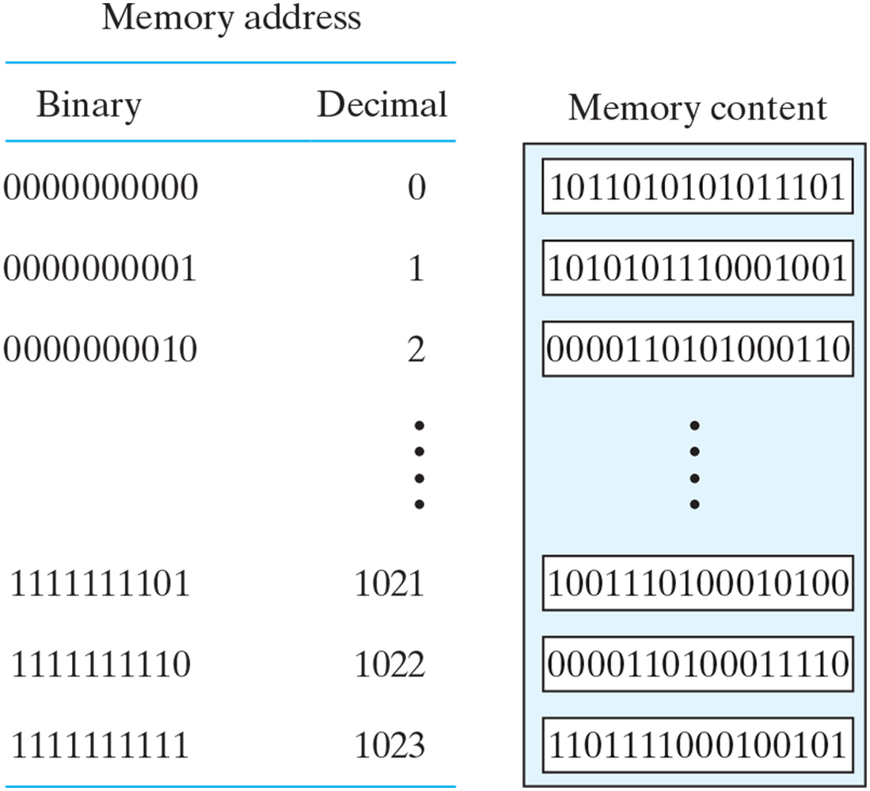
Contents of a 1024 × 16 memory.

Slide 6
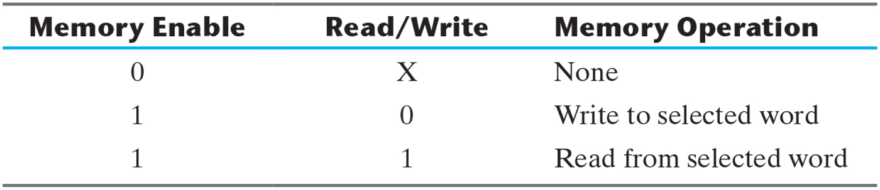
Control Inputs to Memory Chip.

Slide 7
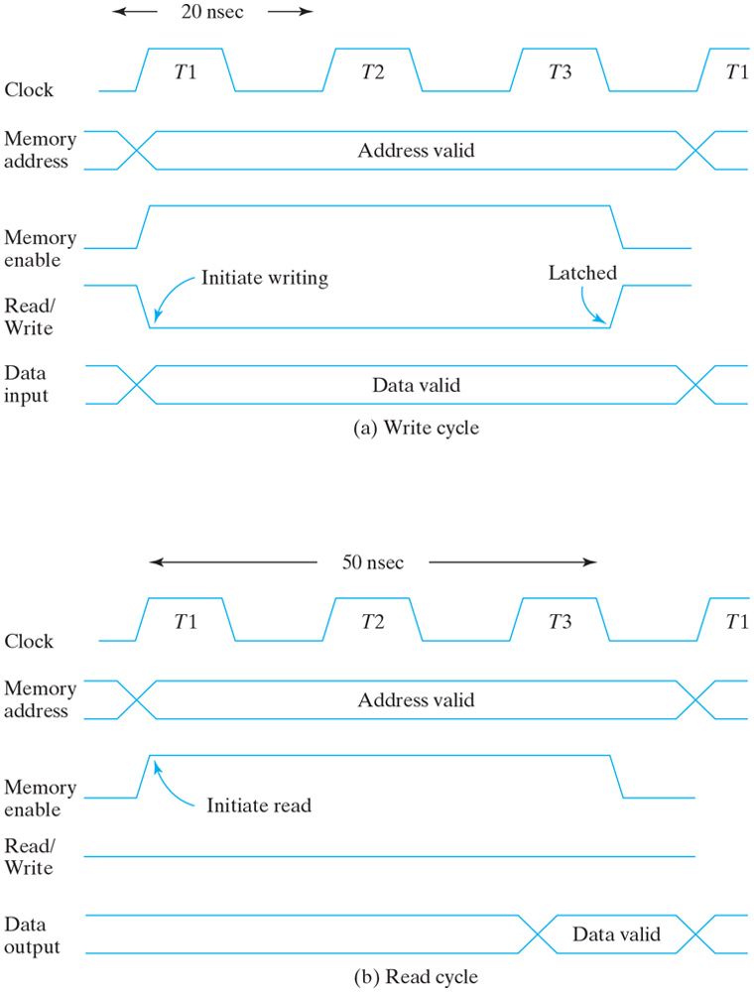
Memory cycle timing waveforms.

Slide 8
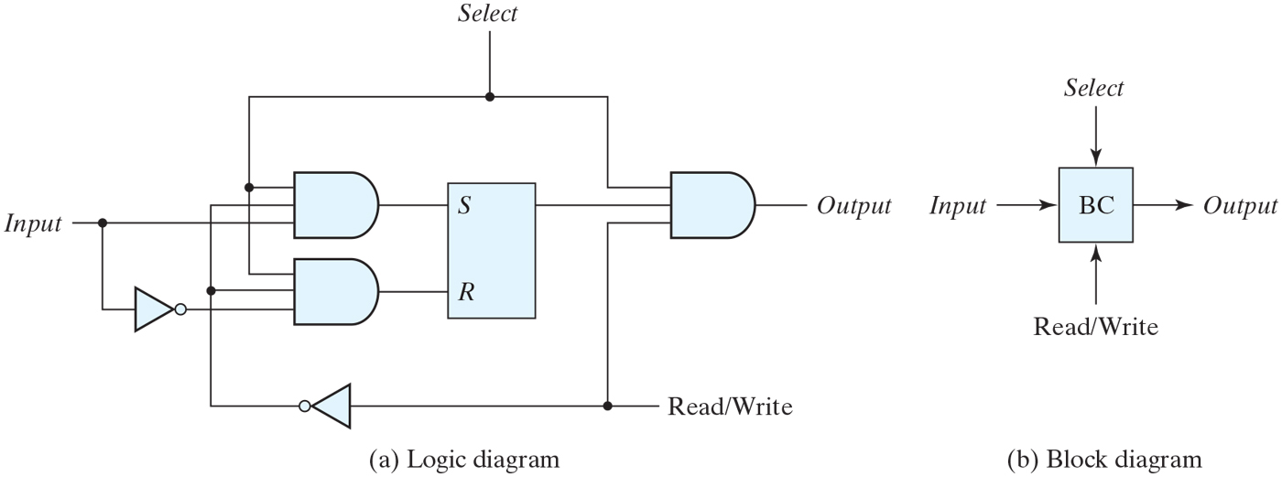
Memory cell.

Slide 9
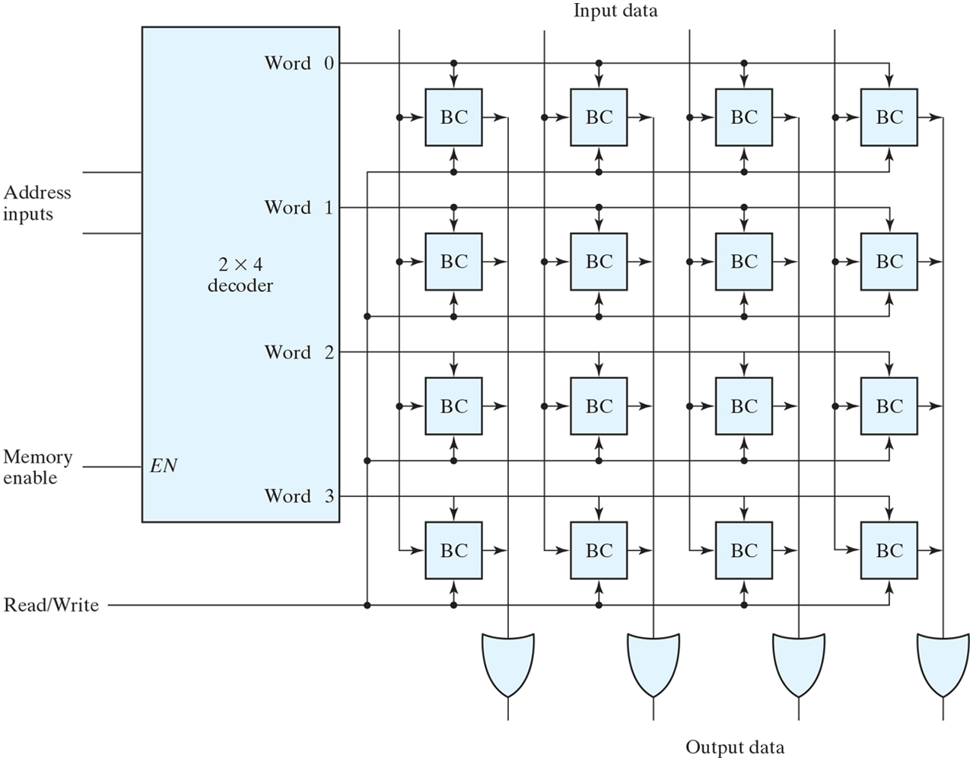
Diagram of a 4 × 4 RAM.

Slide 10
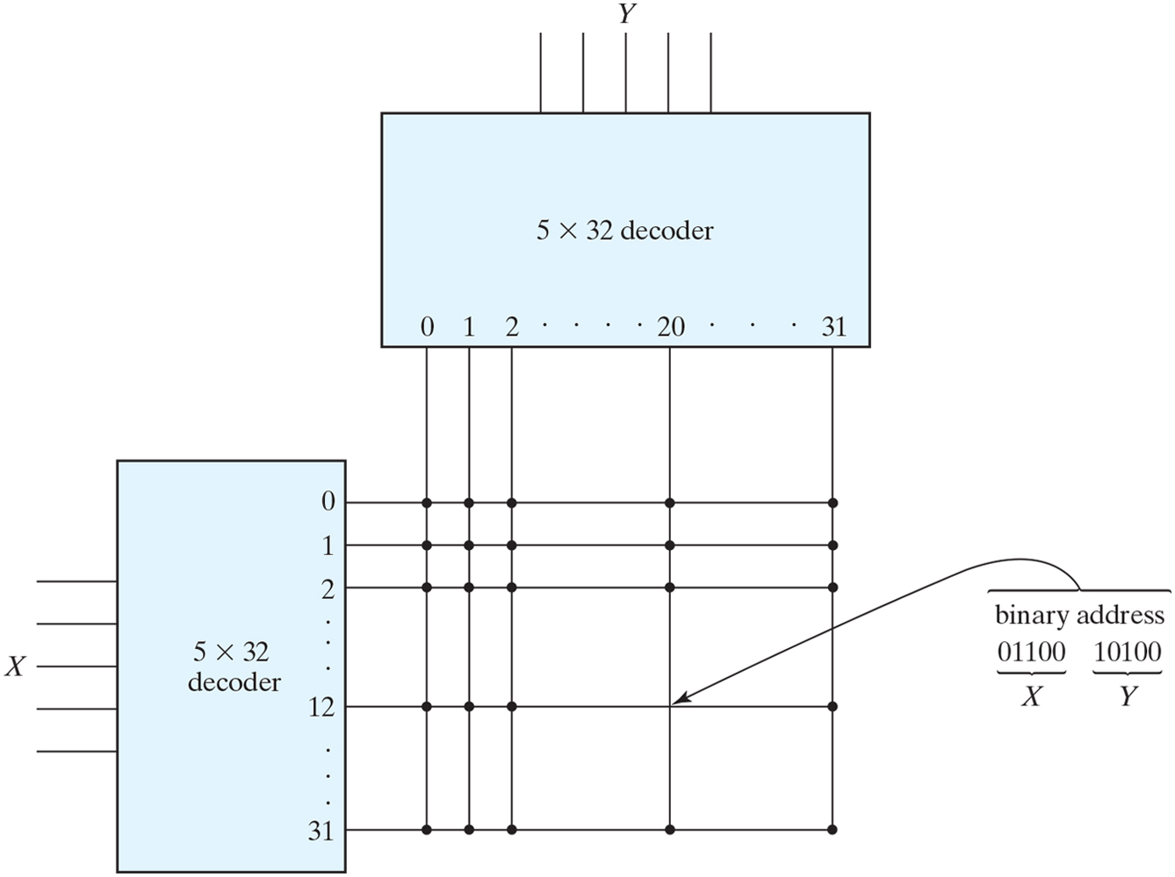
Two-dimensional decoding structure for a 1K-word memory.

Slide 11
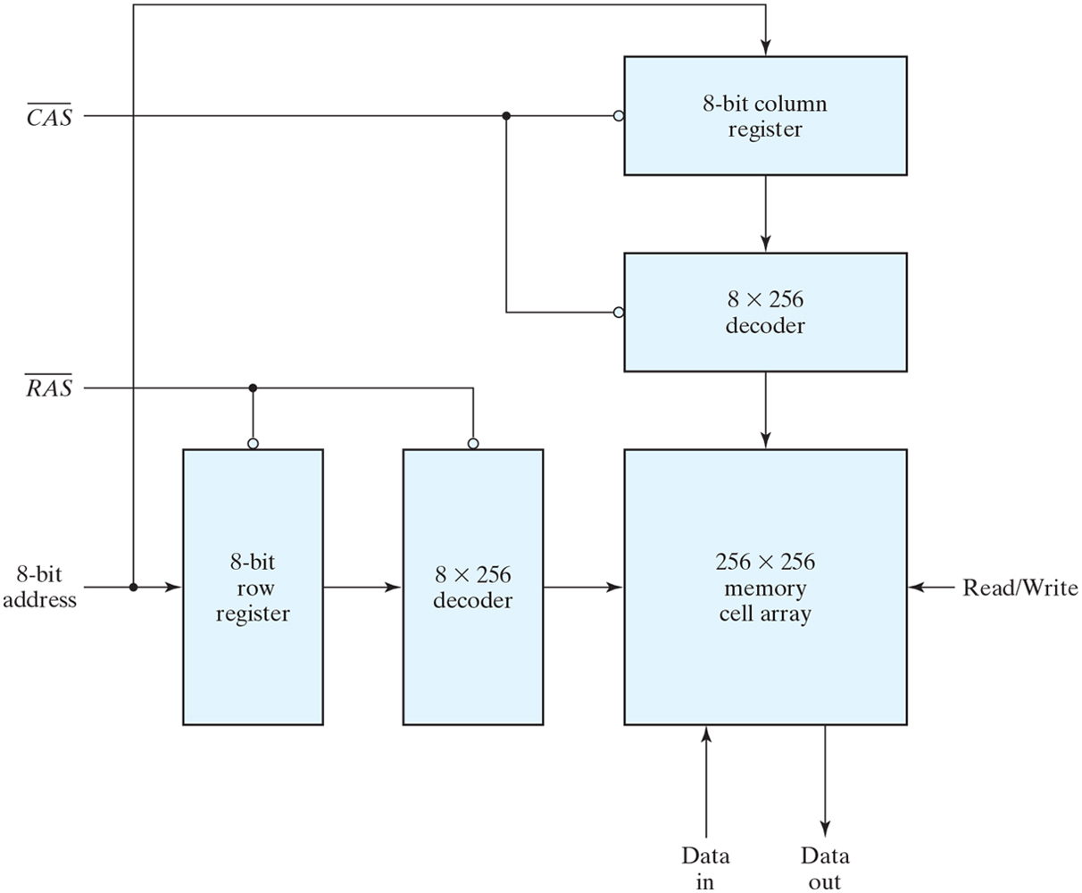
Address multiplexing for a 64K DRAM.

Slide 12
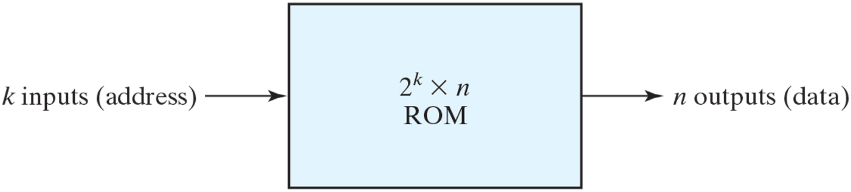
ROM block diagram.

Slide 13
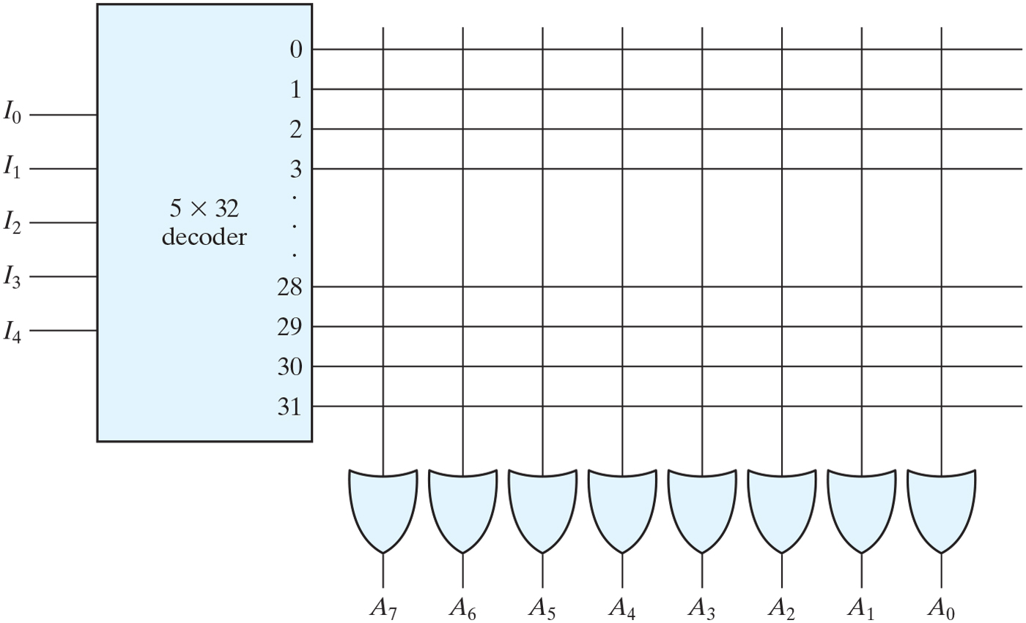
Internal logic of a 32 × 8 ROM.

Slide 14
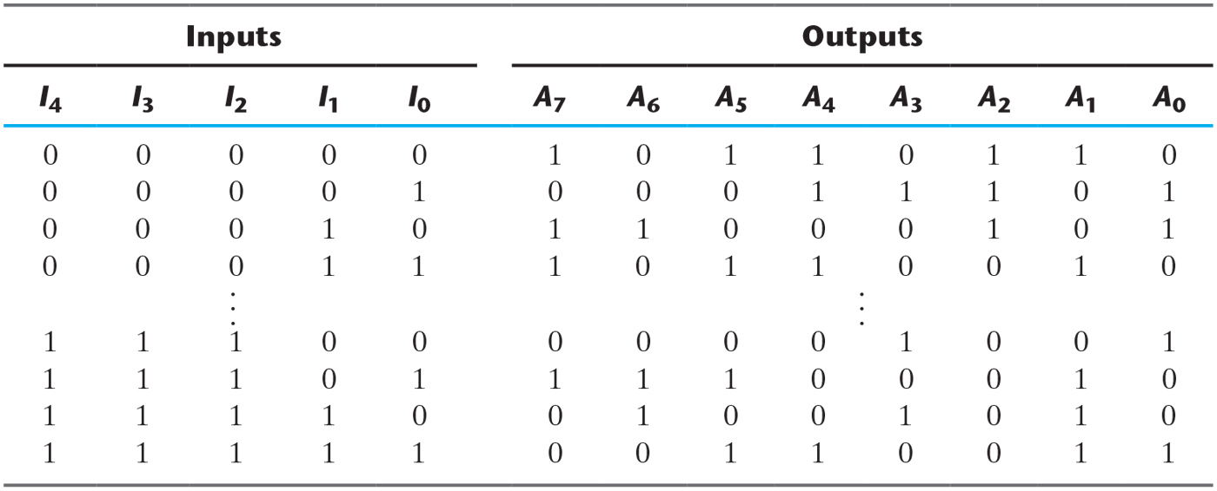
ROM Truth Table (Partial).

Slide 15
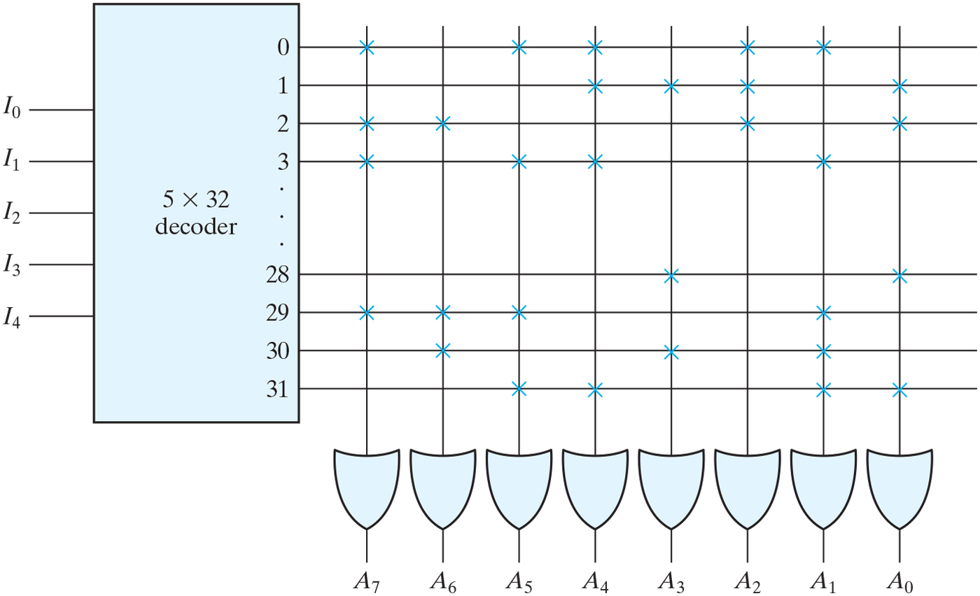
Programming the ROM according to the previous Table

Slide 16
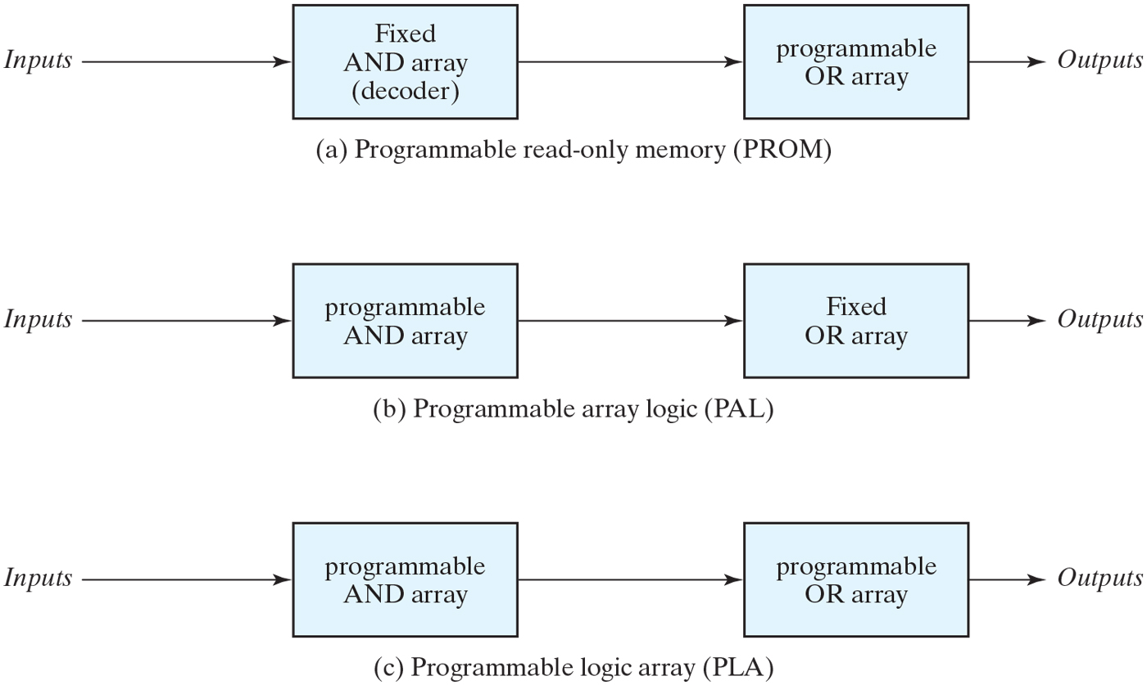
Basic configuration of three PLDs.

Slide 17
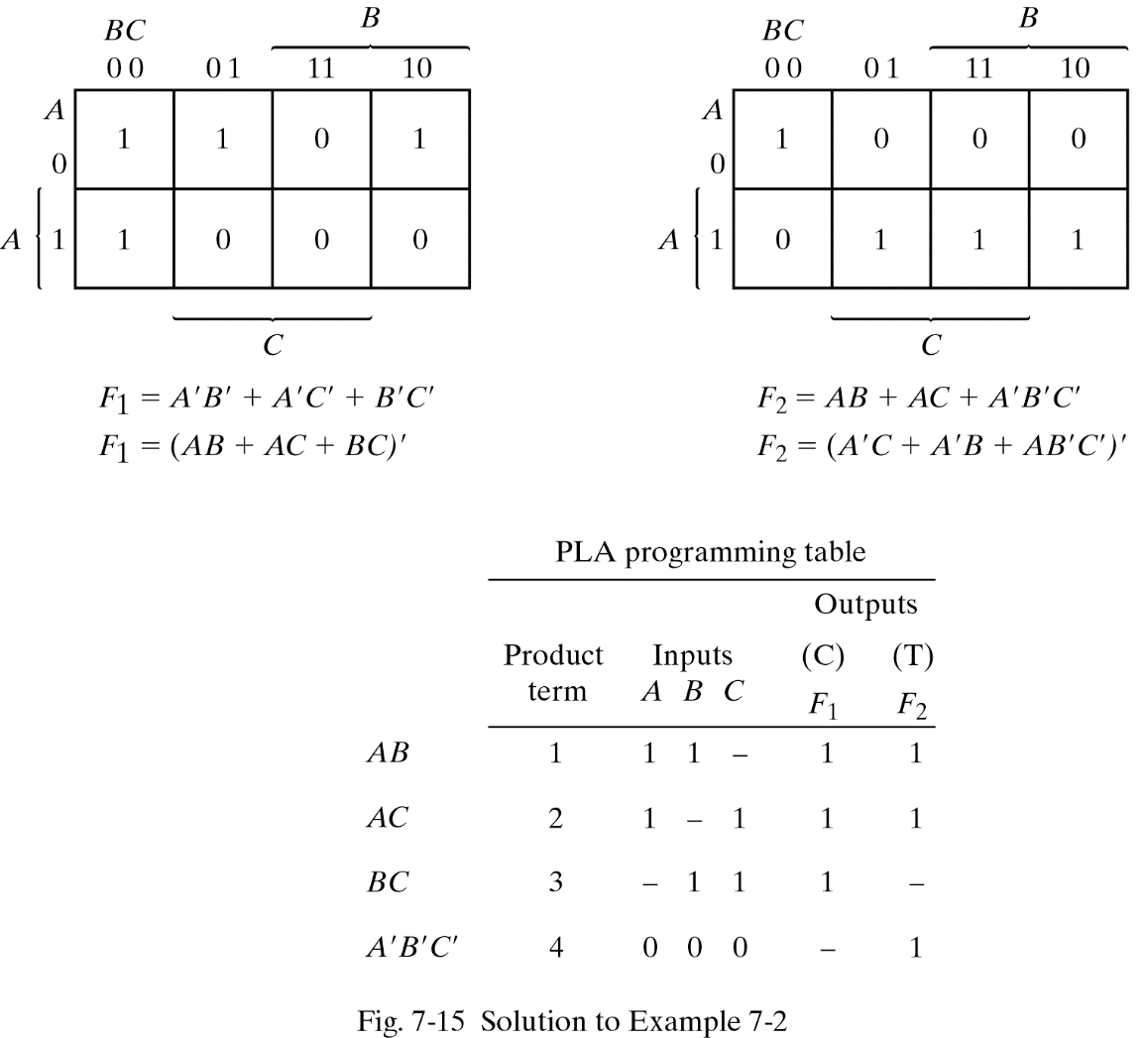
PLA Programming

Slide 18
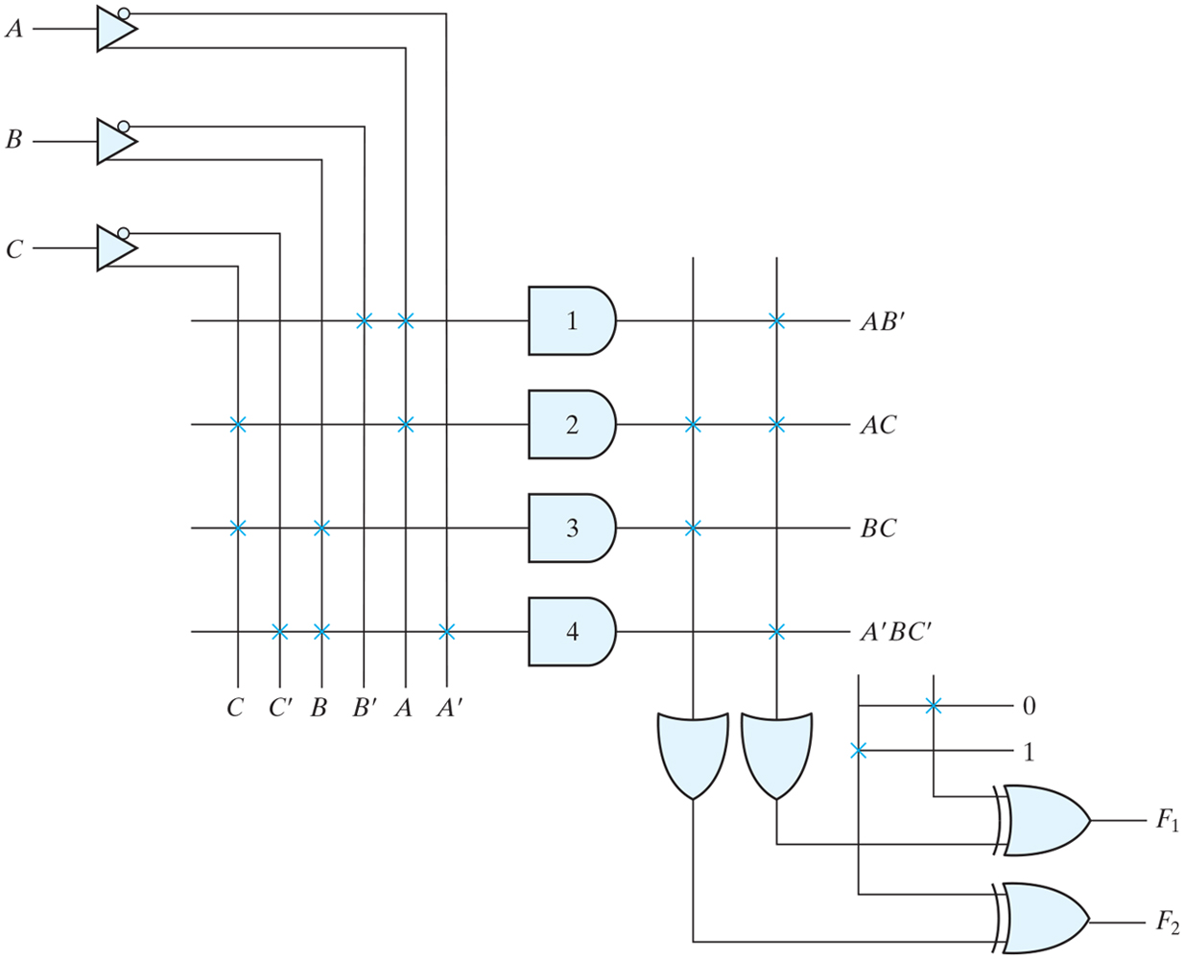
PLA with three inputs, four product terms, and two outputs.

Slide 19
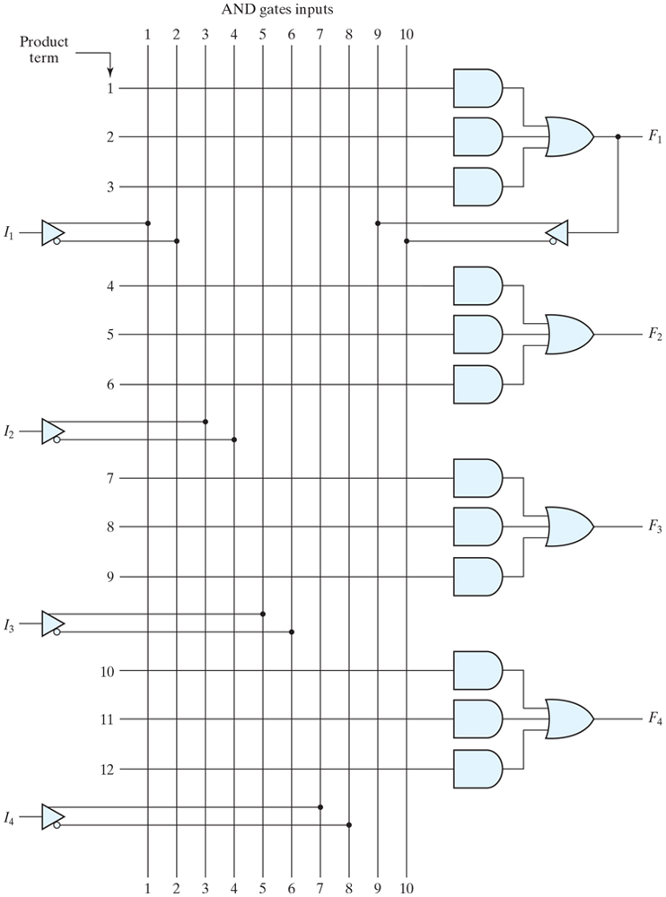
PAL with four inputs, four outputs, and a three-wide AND–OR structure.

Slide 20
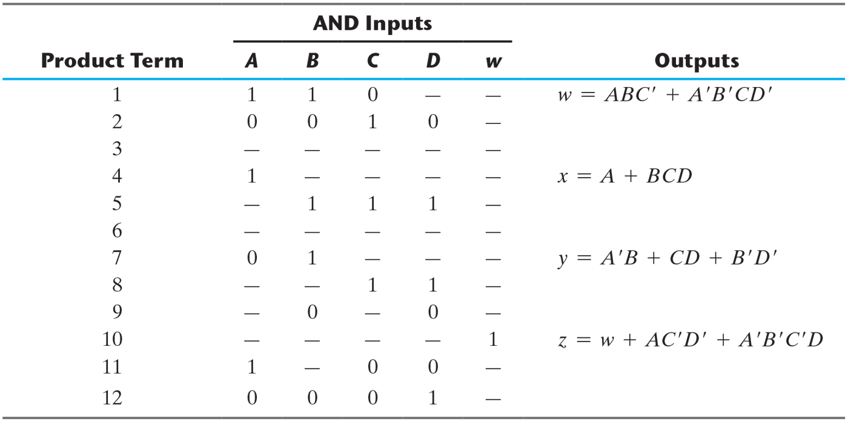
PAL Programming Table.

Slide 21
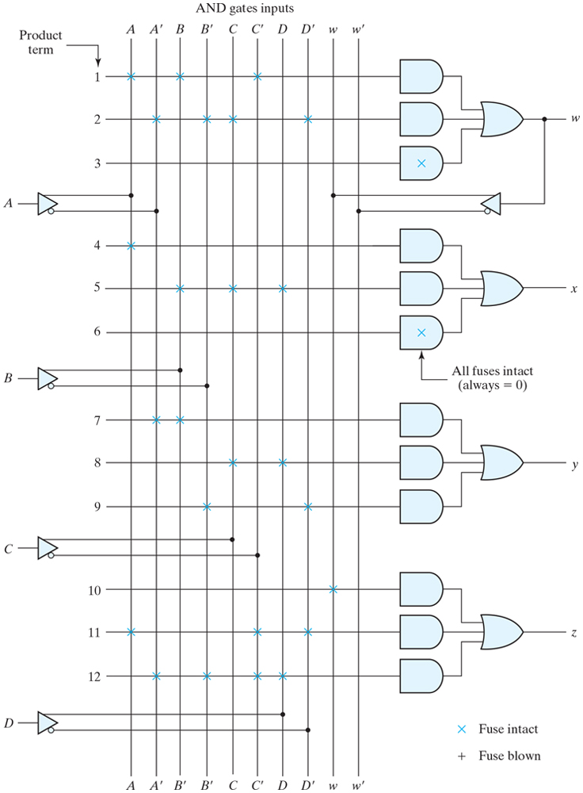
Fuse map for PAL

Slide 22
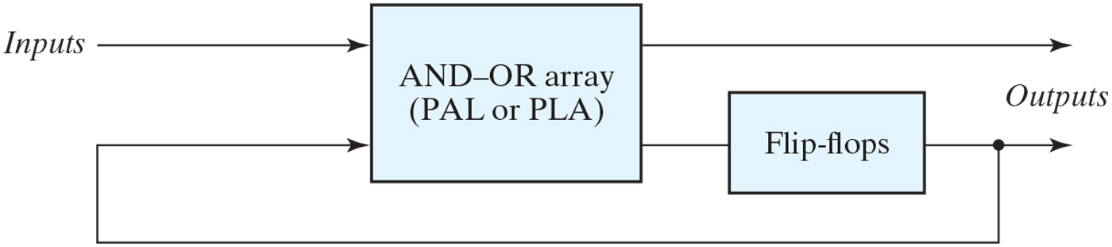
Sequential programmable logic device.

Slide 23
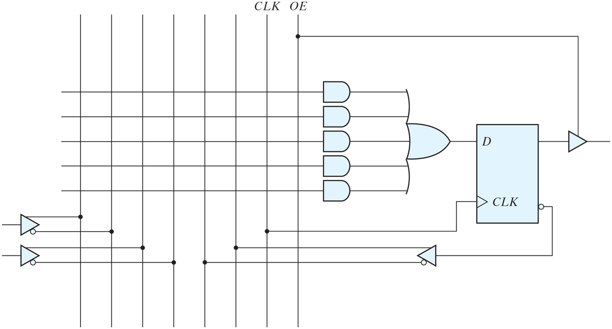
Basic macrocell logic.

Slide 24
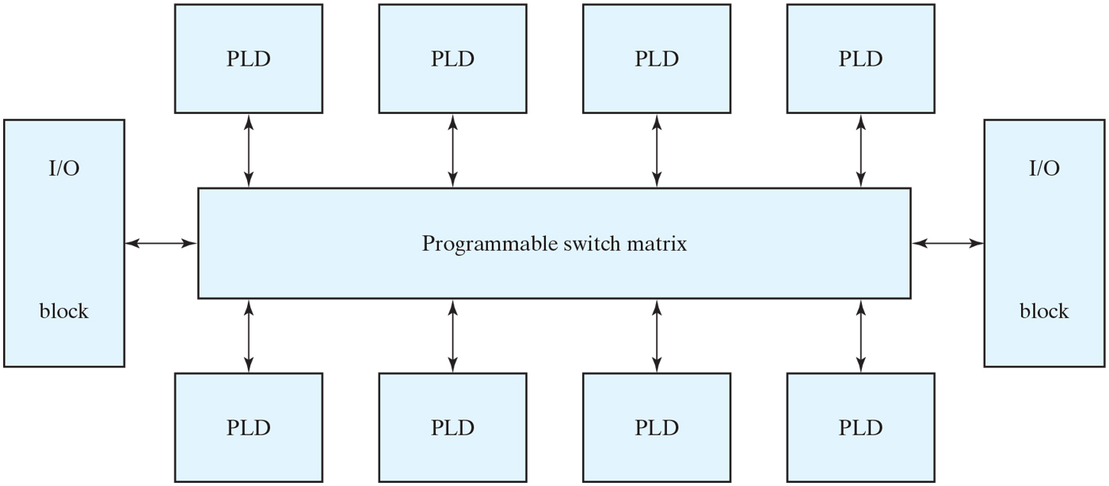
General CPLD configuration.

Slide 25
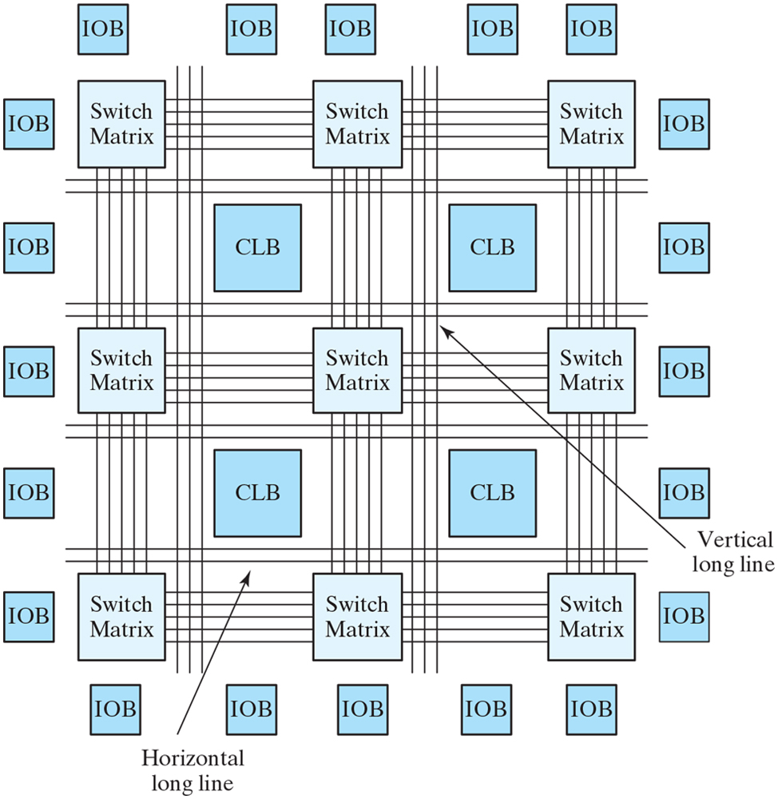
Basic architecture of Xilinx Spartan and predecessor devices.

Slide 26
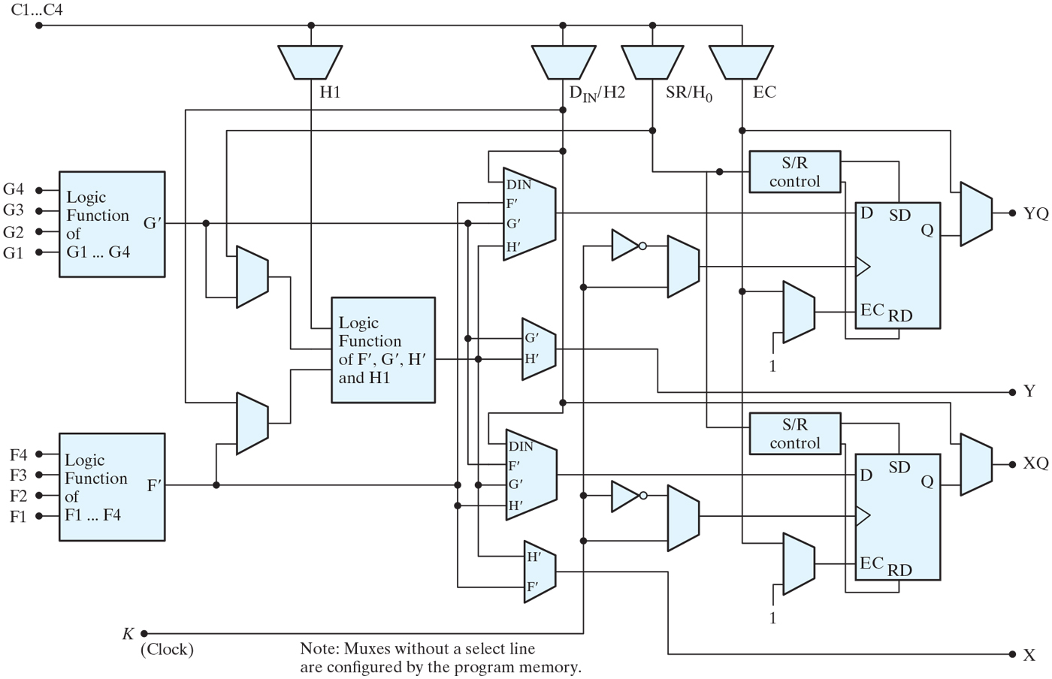
CLB architecture.

Slide 27
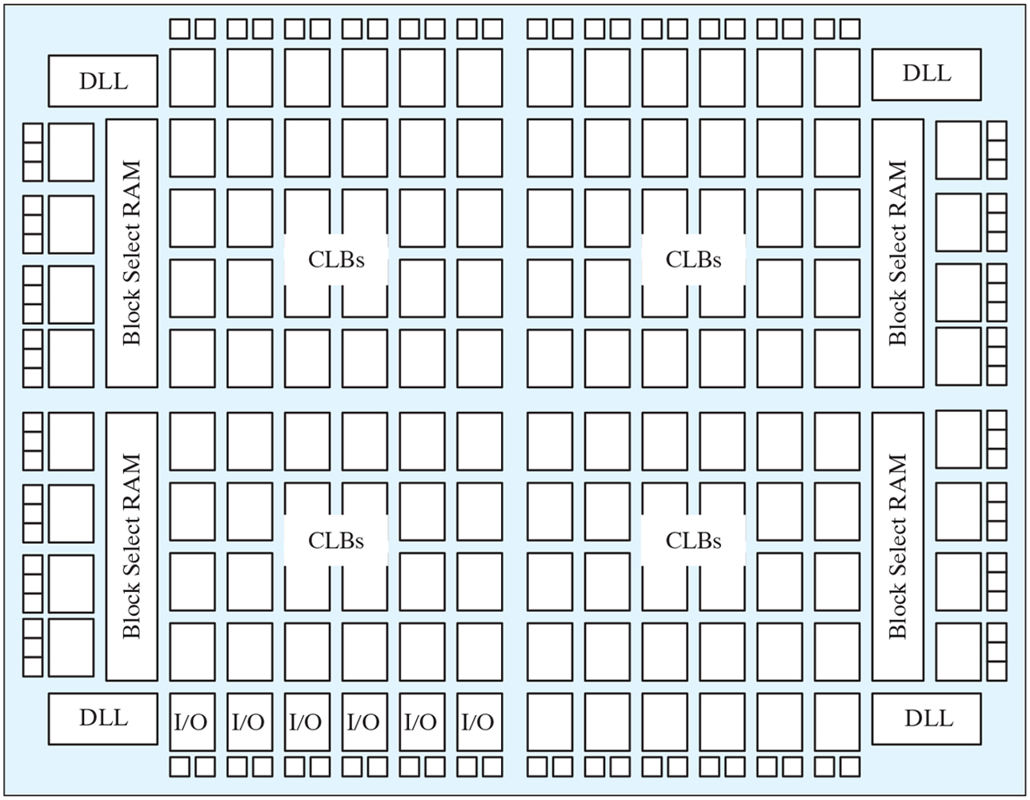
Xilinx Spartan II architecture.

